Slide 1
MongoDB Interview
Q/A
Akshat Kumar
Kushal Doshi
Malhar Khimsaria
Vivek Dhandha

Slide 2
MongoDB Interview Q/A
Explain what is MongoDB? Mongo-DB is a document based database which provides high performance, high availability and easy scalability
What is Namespace in MongoDB? MongoDB stores BSON (Binary Interchange and Structure Object Notation) objects in the collection. The concatenation of the collection name and database name is called a namespace
What is sharding in MongoDB? The procedure of storing data records across multiple machines is referred as Sharding. It is a MongoDB approach to meet the demands of data growth. Each partition is referred as shard or database shard

Slide 3
MongoDB Interview Q/A
Explain what is a replica set? A replica set is a group of mongo instances that host the same data set. In replica set, one node is primary, and another is secondary. From primary to the secondary node all data replicates.
What is the syntax to create a collection and to drop a collection in MongoDB? Syntax to create collection in MongoDB is db.createCollection(name,options) Syntax to drop collection in MongoDB is db.collection.drop()
Explain what is the role of profiler in MongoDB? MongoDB database profiler shows performance characteristics of each operation against the database. You can find queries using the profiler that are slower than they should be.

Slide 4
MongoDB Interview Q/A
Explain what are indexes in MongoDB? Indexes are special structures in MongoDB, which stores a small portion of the data set in an easy to traverse form. Ordered by the value of the field specified in the index, the index stores the value of a specific field or set of fields.
Mention what is the command syntax for inserting a document? For inserting a document command syntax is database.collection.insert (document)
How does MongoDB provide consistency? MongoDB uses the reader–writer locks, allowing simultaneous readers to access any supply like a database or a collection but always offering private access to single writes
What are alternatives to MongoDB? Cassandra, CouchDB, Redis, Riak, Hbase are a few good alternatives

Slide 5
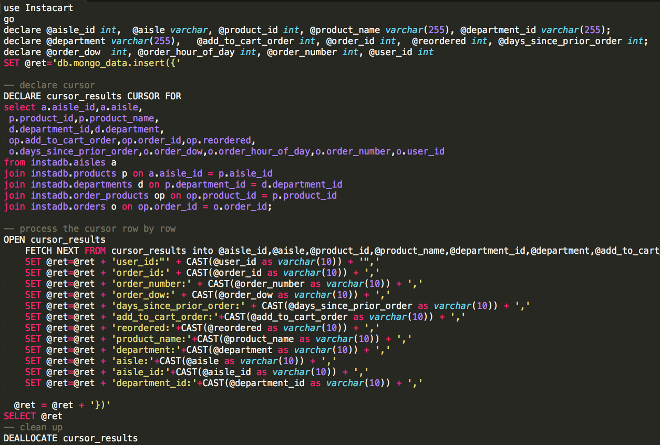
Stored PROC

Slide 6
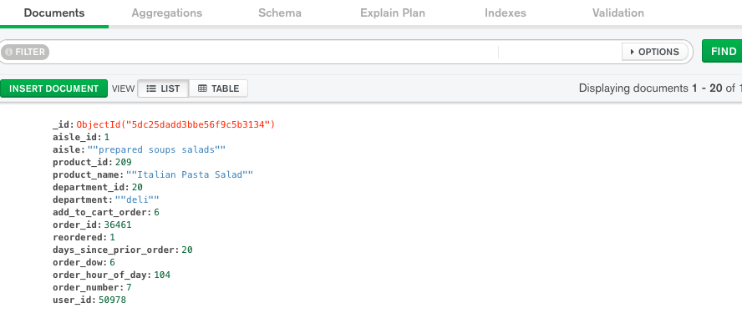
MongoDB Instacart

